Slide 1
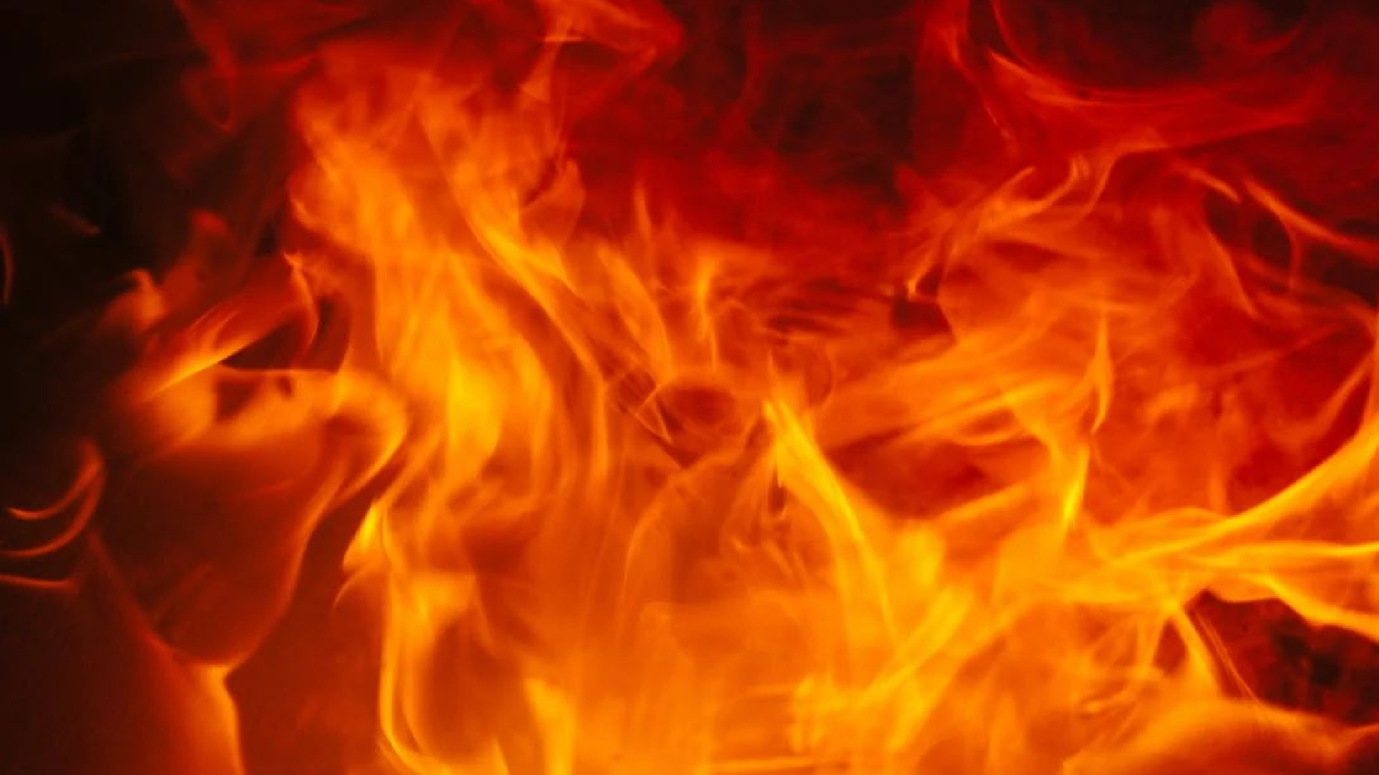


Fireballs & Bolides
Kameron Thao Leah Nash Nou Yang
Valerie Grannemann-Barber

Slide 2
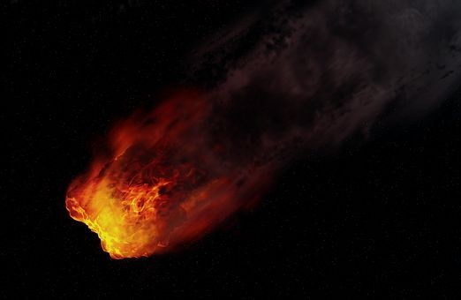
What is a Fireball?
The visible part of a meteoroid/ shooting star that has entered the Earth’s atmosphere
Fireballs are e ceptionally bright, but usually only visible at night
Fireballs reach a visible magnitude of -3 or brighter
Exploding ﬁreballs are called bolides
Notes:
Leah

Slide 3
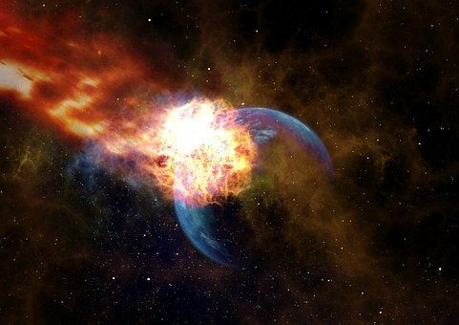
The Data
Source: Fireballs (cneos.nasa.gov)
Fireball event sightings captured by US Government sensors and ground observers
Documentation dates as far as 1988
Currently over 900 records
Data components:
Date/ Time
Latitude / Longitude
Altitude
Velocity
Total Radiated Energy
Calculated Total Impact Energy
Notes:
Kameron

Slide 4

The Process
Data Cleaning
Converted data types
Extracted data
Insert new columns
Database: SQLite
Track: A dashboard with views and interactive visualizations
JS Library: P5.JS
Notes:
Nou

Slide 5

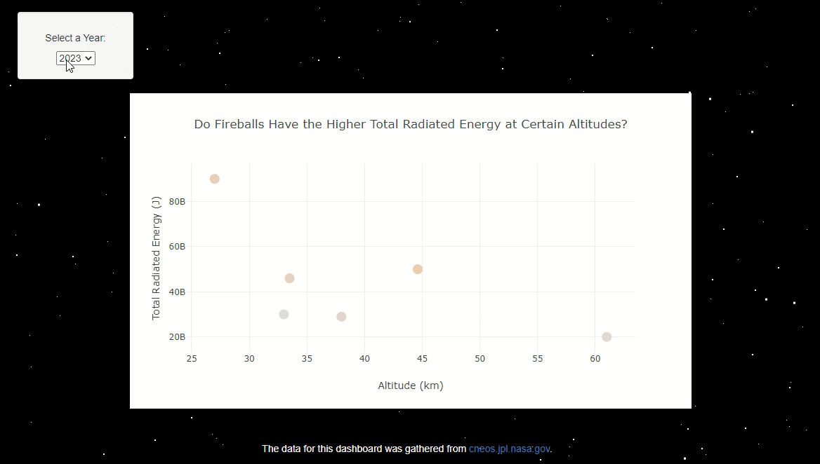
Is there a correlation between a fireball’s total radiated energy in the atmosphere and the altitude at which it is observed?
Total Radiated Energy values ranged from to 20 Billion 3.75 Trillion Joules
Altitude values ranged from 14 to 74 kilometers
Fireball with Highest Total Radiated Energy (3.75 T Joules) at 23.3 km Altitude
Fireballs more commonly have higher total radiated energy at altitudes above 20 kilometers and below 50 kilometers.
Notes:
Nou

Slide 6
Does Altitude Effect the Rate of Velocity of Fireballs?
Altitude (km) - Altitude in kilometers (km) above the reference geoid for event.
Velocity (km/s) - Magnitude of the meteor's pre-impact velocity in kilometers per second (km/s).
Notes:
Kameron

Slide 7
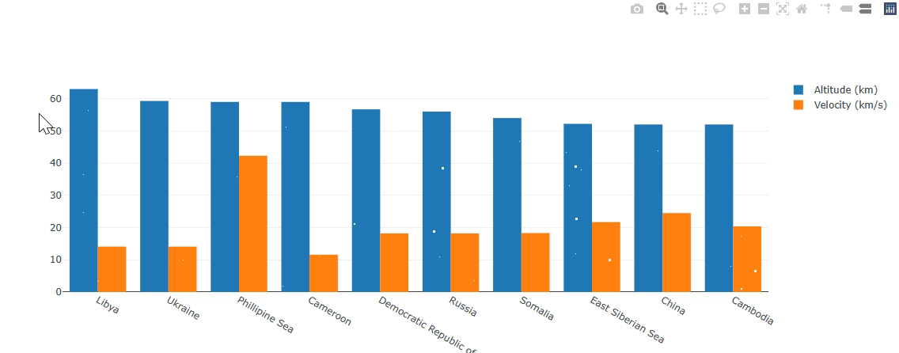
Does Altitude Effect the Rate of Velocity of Fireballs? Cont’d
Top 10 locations ranked based on highest altitude.
Location with highest recorded fireball altitude is Libya (63 km), while lowest are East Siberian Sea, China, and Cambodia (52 km).
China has highest rate of velocity (24.5 km/s) , while Libya has lowest rate (14.1 km/s).
As altitude begins to lower, rate of velocity goes up.
Notes:
Kameron

Slide 8
How does velocity influence the total impact energy?
Velocity : the speed in a given direction
Total impact energy: the amount of energy the meteor absorbs
Calculated Total Energy:
KE = (1/2) mv ^2
KE=Joules m=mass v=velocity
Notes:
Valerie

Slide 9
How does velocity influence the total impact energy?
Velocity of meteorite is 11km-72km (25,000-160,000 mph) entering the atmosphere.
The velocity creates speed, along with the mass of the object, it will create an energy of over 20 million tons of TNT before hitting the Earth’s atmosphere.
By the time it hits Earth’s atmosphere, it slows to an average of 10-70 km/sec.
Once the fireball fragments get closer to the ground, the velocity is around 200-400 mph.
Notes:
Valerie

Slide 10
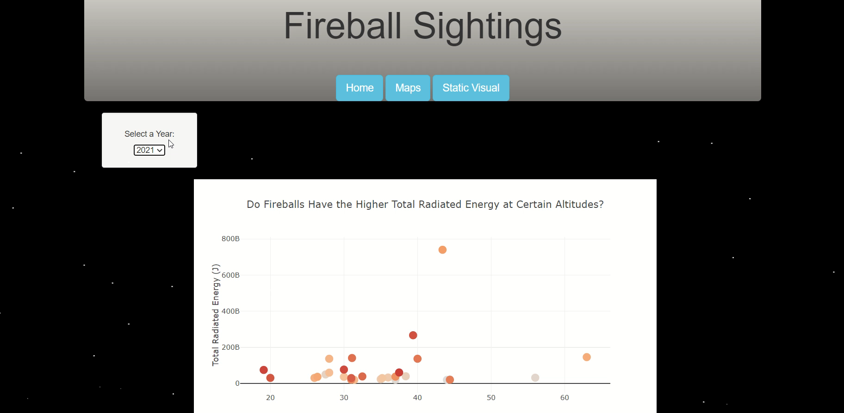
How does velocity influence the total impact energy?
Notes:
Valerie

Slide 11

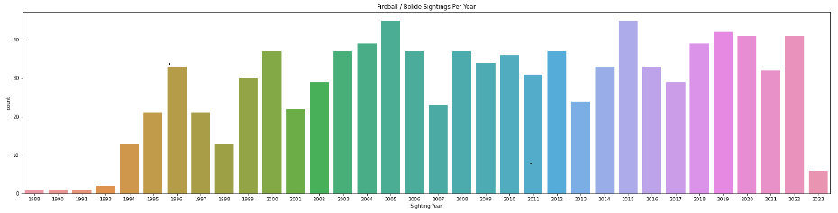
Are the characteristics of a fireball or bolide influenced by location?
Focused on the velocity, radiated energy, impact energy and altitude of sightings from 2012 to 2022
Notes:
Leah

Slide 12
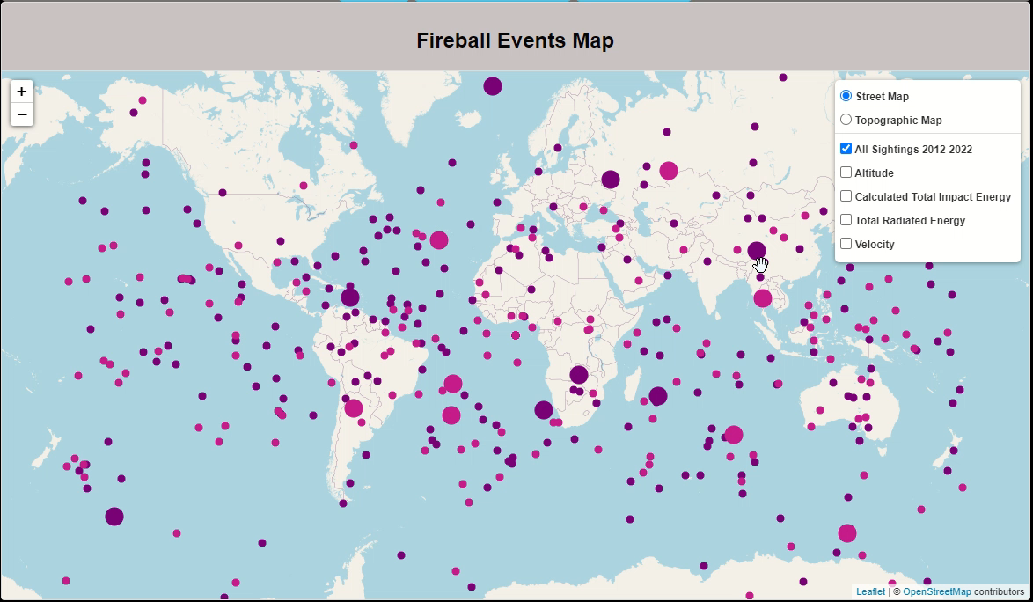
There are no strong trends between the sighting location and fireball or bolide characteristics.
Notes:
Leah

Slide 13
Interesting Facts
What some cultures believe seeing a fireball means?
In some cultures, it signifies sickness or death, or epidemic is coming.
Either to the community or area. On the other hand, some believe it is a sign of promise, luck, and good fortune.
The largest fireball seen? 1908 Tunguska event. The meteor was about 50-60 m (160-200ft) in size exploded at an altitude of 5-10 km (16,000-33,000ft) over a forest in Siberia.
The largest to git the ground?
Chelyabinsk meteorite object was about 3–14 m (10–45 ft) in diameter and 1,190 lbs.
Notes:
Valerie

Slide 14

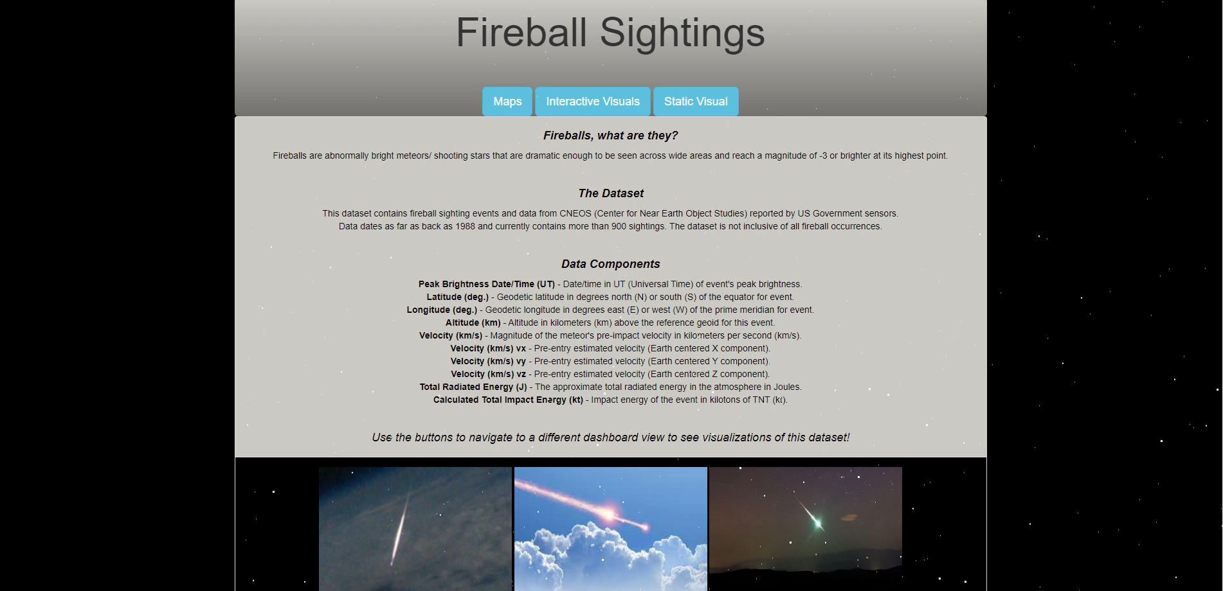

Slide 15
Thank You!

